Slide 1
Introduction to java

Slide 2
What is java
Java is a High Level,general purpose,objected oriented and popular popular programming language.
Java was developed by james Gosling by in 1995.
It is owned by Oracle, and more than 3 billion devices run Java.
Uses of Java
Java works on different platforms (Windows, Mac, Linux, Raspberry Pi, etc.)
It is one of the most popular programming language in the world
Java Platforms
1) Java SE (Java Standard Edition)
It is a Java programming platform. It includes Java programming APIs such as java.lang, java.io, java.net, java.util, java.sql, java.math etc. It includes core topics like OOPs, String, Regex, Exception, Inner classes, Multithreading, I/O Stream, Networking, AWT, Swing, Reflection, Collection, etc.
2) Java EE (Java Enterprise Edition)
It is an enterprise platform that is mainly used to develop web and enterprise applications. It is built on top of the Java SE platform. It includes topics like Servlet, JSP, Web Services, EJB, JPA, etc
3) Java ME (Java Micro Edition)
It is a micro platform that is dedicated to mobile applications.
4) JavaFX
It is used to develop rich internet applications. It uses a lightweight user interface API.

Slide 3
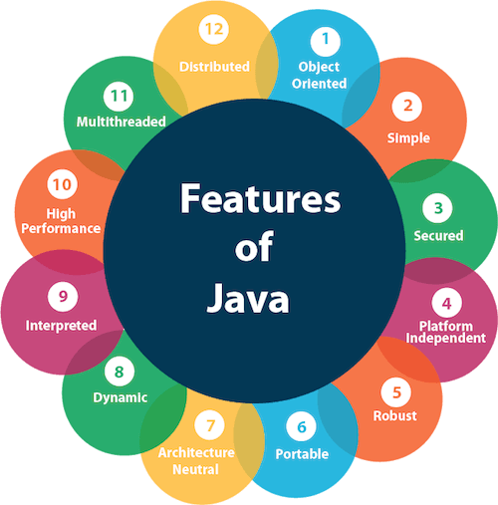
Features of Java

Slide 4
Features of Java
1.Object-oriented
Java is an object-oriented programming language. Everything in Java is an object. Object-oriented means we organize our software as a combination of different types of objects that incorporate both data and behavior.
2. Platform Independent
Java code can be executed on multiple platforms, for example, Windows, Linux, Sun Solaris, Mac/OS, etc. Java code is compiled by the compiler and converted into bytecode. This bytecode is a platform-independent code because it can be run on multiple platforms, i.e., Write Once and Run Anywhere (WORA).
3.Secured
Java is best known for its security. With Java, we can develop virus-free systems.
4.Robust
It uses strong memory management.
There is a lack of pointers that avoids security problems.
Java provides automatic garbage collection which runs on the Java Virtual Machine to get rid of objects which are not being used by a Java application anymore

Slide 5
Portable
Java is portable because it facilitates you to carry the Java bytecode to any platform. It doesn't require any implementation.
High-performance
Java is faster than other traditional interpreted programming languages because Java bytecode is "close" to native code. It is still a little bit slower than a compiled language (e.g., C++). Java is an interpreted language
Distributed
This feature of Java makes us able to access files by calling the methods from any machine on the internet.
Dynamic
Java is a dynamic language. It supports the dynamic loading of classes. It means classes are loaded on demand

Slide 6
Syntax of java and naming convences in java
About Java programs, it is very important to keep in mind the following points.
Case Sensitivity − Java is case sensitive, which means identifier Hello and hello would have
different meaning in Java.
Class Names − For all class names the first letter should be in Upper Case. If several words are
used to form a name of the class, each inner word's first letter should be in Upper Case.
Example: class MyFirstJavaClass
Method Names − All method names should start with a Lower Case letter. If several words are
used to form the name of the method, then each inner word's first letter should be in Upper Case.
Example: public void myMethodName()
Program File Name − Name of the program file should exactly match the class name.
When saving the file, you should save it using the class name (Remember Java is case sensitive)
and append '.java' to the end of the name (if the file name and the class name do not match, your
program will not compile).
Example: Assume 'MyFirstJavaProgram' is the class name. Then the file should be saved
as 'MyFirstJavaProgram.java'
public static void main(String args[]) − Java program processing starts from the main() method
which is a mandatory part of every Java program.

Slide 7
Anatomy of the Java Program
Documentation Section
Package Declaration
Import Statements
Interface Section
Class Definition
Class Variables and Variables
Main Method Class
Methods and Behaviors

Slide 8
Compling and Running of Java
All programs can be saved .Java (ex Welcome.java)
For compiling the program javac Filename .java
For running and executing the program –java Filename
JDK(Java Development kit)
JDK (Java Development Kit) is a software development kit required to develop applications in Java. When you download JDK, JRE is also downloaded with it.
In addition to JRE, JDK also contains a number of development tools (compilers, JavaDoc, Java Debugger, etc)
JRE (Java Runtime Environment).
JRE (Java Runtime Environment) is a software package that provides Java class libraries, Java Virtual Machine (JVM), and other components that are required to run Java applications.

Slide 9
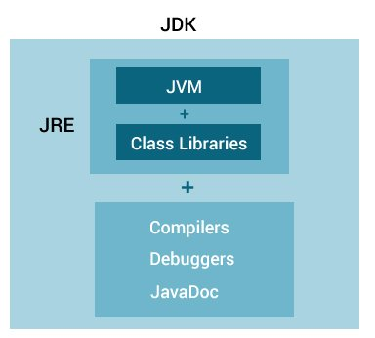
RelationShip between JDK,JRE and JVM
JVM (Java Virtual Machine)
JVM (Java Virtual Machine) is an abstract machine that enables your computer to run a Java program.
When you run the Java program, Java compiler first compiles your Java code to bytecode. Then, the JVM translates bytecode into native machine code (set of instructions that a computer's CPU executes directly).
Java is a platform-independent language. It's because when you write Java code, it's ultimately written for JVM but not your physical machine (computer). Since JVM ​executes the Java bytecode which is platform-independent, Java is platform-independent.

Slide 10
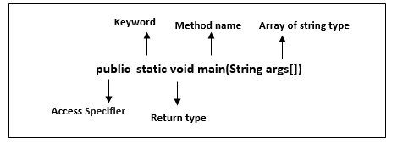
JIT(Just InTime)
JIT compiler is a just in time compiler that is used in java to improve the performance the code at runtime
the code will edited at runtime by identifying Hotspots.
Java main() method
The main() is the starting point for JVM to start execution of a Java program. Without the main() method, JVM will not execute the program. The syntax of the main() method is:
Input from the user
Scanner sc=new Scanner(System.in);
Java input scanner class
*java.util package-to read input data from user
1.import java.util.Scanner
2.Create Scanner class object
Scanner sc=new Scanner(System.in);

Slide 11
Methods of Java Scanner Class
Method | Description
int nextInt() | It is used to scan the next token of the input as an integer.
float nextFloat() | It is used to scan the next token of the input as a float.
double nextDouble() | It is used to scan the next token of the input as a double.
byte nextByte() | It is used to scan the next token of the input as a byte.
String nextLine() | Advances this scanner past the current line.
boolean nextBoolean() | It is used to scan the next token of the input into a boolean value.
long nextLong() | It is used to scan the next token of the input as a long.
short nextShort() | It is used to scan the next token of the input as a Short.

Slide 12
Identifiers in Java
Identifiers in Java are symbolic names used for identification. They can be a class name, variable name, method name, package name, constant name, and more. However, In Java, There are some reserved words that can not be used as an identifier.
Examples of Identifier
HelloJava (Class name)
main (main method)
String (Predefined Class name)
args (String variables)
System (Predefined class)
out (Variable name)
println (method)
Rules
A valid identifier must have characters [A-Z] or [a-z] or numbers [0-9], and underscore(_) or a dollar sign ($)
There should not be any space in an identifier.
An identifier should not contain a number at the starting.
We can't use the Java reserved keywords as an identifier such as int, float, double, char, etc

Slide 13
Literals
In Java, literal is a notation that represents a fixed value in the source code.
In Java, literals are the constant values that appear directly in the program. It can be assigned directly to a variable.
Type Casting
1.Implicit type Casting
The process of converting one type of object and variable into another type is referred to as Typecasting. When the conversion automatically performs by the compiler without the programmer's interference, it is called implicit type casting or widening casting.
Smaller Data type to larger datatype.
2.Explicit type casting
Converting a higher data type into a lower one is called narrowing type casting. It is also known as explicit conversion or casting up. It is done manually by the programmer. If we do not perform casting then the compiler reports a compile-time error.

Slide 14
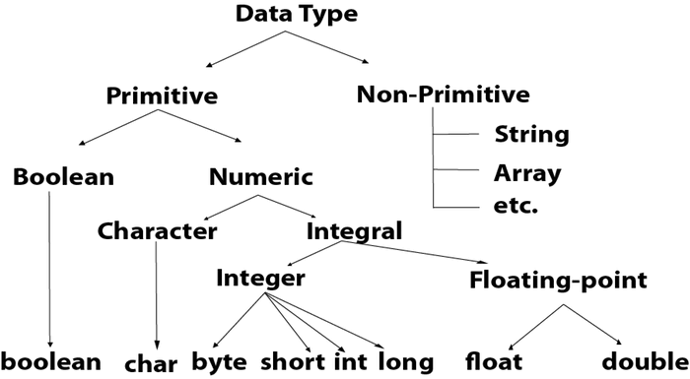
Data Types in Java There are two types of Data types in Java 1.Primitive Datatype 2.NonPrimitive Datatype

Slide 15
Data types Values and sizes
Data Type | Size | Description
byte | 1 byte | Stores whole numbers from -128 to 127
short | 2 bytes | Stores whole numbers from -32,768 to 32,767
int | 4 bytes | Stores whole numbers from -2,147,483,648 to 2,147,483,647
long | 8 bytes | Stores whole numbers from -9,223,372,036,854,775,808 to 9,223,372,036,854,775,807
float | 4 bytes | Stores fractional numbers. Sufficient for storing 6 to 7 decimal digits
double | 8 bytes | Stores fractional numbers. Sufficient for storing 15 decimal digits
boolean | 1 bit | Stores true or false values
char | 2 bytes | Stores a single character/letter or ASCII values

Slide 16
keywords
Java keywords are also known as reserved words. Keywords are particular words that act as a key to a code. These are predefined words by Java so they cannot be used as a variable or object name or class name.
Java Keywords List
abstract | assert | boolean | break | byte
case | catch | char | class | const
continue | default | do | double | else
enum | extends | final | finally | float
for | goto | if | implements | import
instanceof | int | interface | long | native
new | package | private | protected | public
return | short | static | strictfp | super
switch | synchronized | this | throw | throws
transient | try | void | volatile | while

Slide 17
Operators
OPERATORS AND OPERANDS COMBINED TO FORM EXPRESSIONS OPERANDS:
1.unary-acts on one operand
2.binary-acts on two operands
3ternary-acts on three operands
ARITHEMATIC OPERATIONS:
+ ->unary plus (binary addition)
- ->unary minus(binary substraction)
* ->multiplication
/ ->divison
% ->modulus
2.COMPARISION OR RELATIONAL:
> - checks whether greater than or not
< = - checks whether lesser than or not
>= - checks whether greater than or equal to
<= - checks whether less than or equal to
== - checks whether equal or not
!= - not equal to

Slide 18
Operators
3.LOGICAL OPERATORS
logical and-&&
logical or-||
logical not-!
1.logical AND (&&):-condition1 condition2 condition1&&condition2
T T T
F T F
T F F
F F F

Slide 19
Logical Operators
4.logical OR(||)
condition1 condition2 condition1||condition2
T T T
F T T
T F T
F F F
logical NOT(!)
condition1 !condition1
T F
F T

Slide 20
Assignment Operators
=
SHORTHAND ASSIGNMENT
+=
*=
-=
/=
%=
ex: variable=variable+exp; can be written as +=exp;
5.INCREMENT AND DECREMENT OPERTAOR
++ ->increment by 1
-- ->decrement by 1
ex:
m=5
a=m++
first value of m is assigned to a
m is incremented by 1
a=5
m=6

Slide 21
opeartors
6.TERNARY OPERATOR
exp1?exp2:exp3
4>5? exp1=exp3,5
z=(a>b)?(a>c)?a:c):(b>c)b:c to print max value
7.BITWISE OPERATOR
bitwise and-&
bitwise or-|
bitwise exor
right shift
left shift
left shift
1.bitwiseAND(&):- RETURN 1 IF BOTH BITS ARE 1 ELSE RETUENS 0
X Y X&Y
0 0 0
0 1 0
1 0 0
1 1 1

Slide 22
operators
2.bitwiseOR(|):- RETURN 1 ANY OF THE BIT IS 1 ELSE RETUENS 0
X Y X|Y
0 0 0
0 1 1
1 0 1
1 1 1
3.bitwiseXOR(^):- RETURN 0 IF BOTH BITS ARE SAME ELSE RETUNS 1
X Y X^Y
0 0 0
0 1 1
1 0 1
1 0
4.bitwise compliment(~):- INVERSE OF BIT
X ~X
0 1
1 0

Slide 23
Special Operators
1.instanceof
chech weather it belongs to that class or not
ex:name=ravi
boolean b=nameinstance of the string-true
boolean c=name instance of int-false
2.New
create the objects of the class
3.member operator(.)
object name .method name
Expression Evaluation
more than one operator in expression
precedence of the operator
1.* ,/ and % highest than + and -
2.if * and /,+ and - is there then highest is
associativity- left to right-arithmetic operators
3.paranthes will high highest priority
4.z=++m + m++
p0st increment has high priority

Slide 24
Control Statements
controlling the order of exceution of statements.there are two types.
1.conditional statements
2.iterative statements or loops
conditional statements
1.simple if
2.if else
3.elseif ladder
4.nested if
5.switch
1.simple if
syntax:if(condition)
{
statement bock;
}
statement x
if statement block contains many statemets it will be one only
if single condition is there no need to put curle braces

Slide 25
Conditional Statements
2.If else
if(condition) {
statement 1; //executes when condition is true
}
else{
statement 2; //executes when condition is false
}
3.Else if Ladder
if(condition 1) {
statement 1; //executes when condition 1 is true
}
else if(condition 2) {
statement 2; //executes when condition 2 is true
}
else {
statement 2; //executes when all the conditions are false
}

Slide 26
Conditional Statements
4.Nested If
if(condition 1) {
statement 1; //executes when condition 1 is true
if(condition 2) {
statement 2; //executes when condition 2 is true
}
else{
statement 2; //executes when condition 2 is false } }
5.Switch statement
switch (expression){
case value1:
statement1;
break;
---------
case valueN:
statementN;
break;
default:
default statement;
}

Slide 27
Iterative Statements or Loops
for loop
syntax:
for(iniliazation;condition;increment and decrement)
{
statements block;
}
statements x;
For loop- for loop is used when we know the number of times we need to itirrate.for loop is entry controlled loop.
2.while loop
syntax:while(condition)
{
statement block;
}
statement x;
while loop- the while loop checks the condition and then only enters the loop. while loop is entry controled loop and the while loop is preferred to use when we don't know the how many times to loop iterate.

Slide 28
Loops
3.Do while loop
Syntax:
do
{
ststements block
}
while(condition);
statements x;
The do while loop runs atleast once util the while condition is satisfied. do while is exit controlled loop.
the do while loop is used when the block of statement execuite at least one time irrespective of condition.

Slide 29
Jumping Statements
1.break
2.continue
1.break
inside the loop and loop will be terminated.
inside the switch and comes out of the switch.
2.continue
inside the loop can be exceuted.
the exceution of the loop will be susoended for thar particular iteration and control goes to next iteration.
3.Return
It will return values and it will any type like Boolean integer float and double
Ex:Public void Boolean isprime()

Slide 30
Program By using Method function
Import java.util.Scxanner;
Public class MainClass{ //at least should be public
Public static void main(String[] args){
InsideClass a=new InsideClass();//creating of an object of the class
a.inside(); //calling the method
}
}
class ClassInside{
Public void inside(){
Scanner sc=new Scanner(System.in);
Read the value
process
System.out.println(“output”)
}
}

Slide 31
Arrays
Need of arrays;
1.storing the all values in a single array
2.by using index values we can assign value
3.Array is a group of elements having same data type.
4.All the elements of the array can be stored in contiguous memeory locations.
1.Single Dimesional arrays
Declaring the array;
datatype[] array name; or datatype arrayname[] or arr[]={10,20,30,40}
Initialization of an array;
datattype[] arrayname;
arrayname=new datatype[length];
Reading array from keyboard through Scanner:
Int arr[]=new int(length);
Arr[i]=sc.nextInt();

Slide 32
Two dimensional array
2D array are used in the matrix form
Declaration
datatype[][] arrayname or datatype arrayname[][]
Initialization
datatype arr[][]=new datatype[][];
Array length =arr.length for rows and arr[i].length.

